Slide 1
S c r a b b l e P r o b l e m
Group members:
Milan Dungarani (201601096)
Nisharg Patel (201601102)
Yatin Patel (201601454)

Slide 2
Definition
Scrabble is a word game in which two to four players score points by placing tiles bearing a single letter onto a board divided into a 15×15 grid of squares. The tiles must form words that, in crossword fashion, read left to right in rows or downward in columns, and be included in a standard dictionary or lexicon.

Slide 3
Algorithm
Instead of scanning through the entire lexicon each turn for playable words, we begin by scanning over the board for places where a word could connect to letters already on the board. Then we try to build the word up incrementally, using letters from the rack and the board near the proposed place of attachment. We maintain data structures(DAWG) that make this search one-dimensional,so we never have to look outside of a single row or column of the board during move generation.

Slide 4
Analysis
Reducing the problem to One Dimension
Despite of considering all letter on board we first look into particular one letter and run algorithm on that letter only for one direction(left to right). 7th position from that letter to left side, we will check every letter from rack and check that every word prefix in DAWG(Directed Acyclic Word Graph) or not. If word prefix exist then we add another letter from remaining rack and this recursive process runs again until rack is empty.
2) Cross-Checks
When word is made from that letter, we will cross check that word in scrabble board. We will do same procedure for 6th,5th..,0th position from that letter to left side and store every valid word and it’s starting position from scrabble board.

Slide 5
Generalization
Till now we have considered only one direction(left to right) for one letter. Now we will search for top to bottom by taking transpose of scrabble board matrix. Taking transpose will make every possibility from top to bottom to left to right and we will do same procedure as we have done in Analysis part. This method will make our algorithm easier and shorter. Till now we have searched every word possibility for one particular letter. Now we will run our algorithm for every letter which is on scrabble board. This will give every valid word possibility from that rack for current situation and we will place one output word which has maximum points.

Slide 6
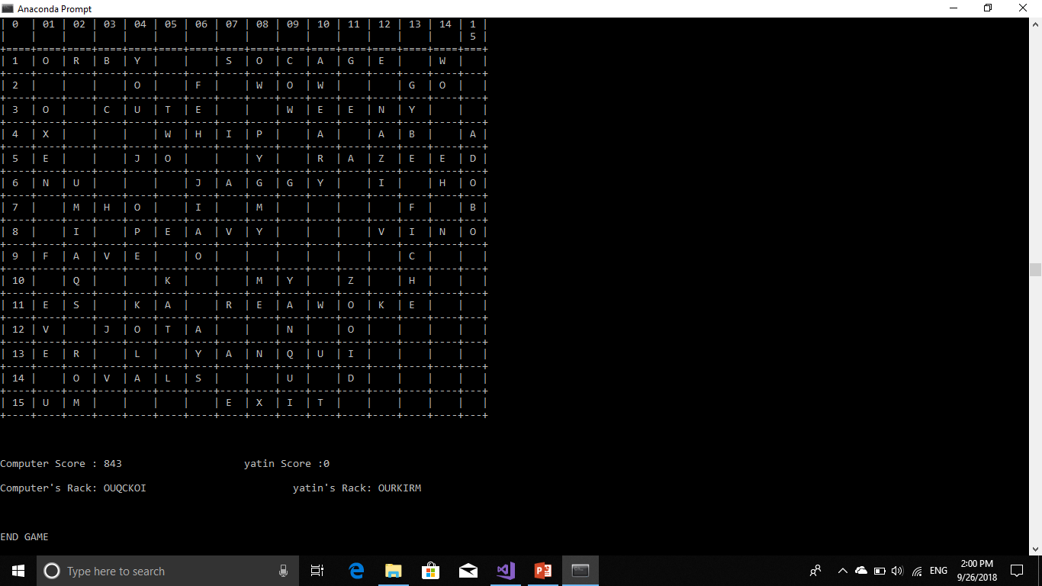
End Game
The game ends when player passes and computer change it’s rack.

Slide 7
Pseudo Code
FindPlace ()
for each element E on board
for i=row-7 to row of board element
checkWord("",row,I,column,Rack)
checkWord("",row+1,I,column,Rack)
checkWord("",row-1,I,column,Rack
MaxPoint()
For every string in Possibility Array
Find the point of that String using the StartRow And StartColumn
If Point is grater then current max
Max= Point of the string
MaxString= String
crossCheck(letter,row,currentColumn)
k=row+1
While there is an element on board at row and CurrentColumn
Word= element + word
Row--
While there is an element on board at k and CurrentColumn
Word= word + element
K++

Slide 8
CheckWord (PartialWord, row,currenColumn,column,Rack)
If PartialWord in dictionary
Insert PartialWord and its StartingRow and column in the possibility array
if Place of currentrow and column is vacant
for each letter in Rack
If there is a Word which hase PartialWord as prefix
and crossCheck(letter,row,currentColumn)
PartialWord= PartialWord+letter
Remove that letter from rack
CheckWord (PartialWord, row, currentColumn+1,column,Rack)
Insert letter to Rack
PartialWord=Partialword-letter
Else
PartialWord = PartialWord + Element from Board
CheckWord (PartialWord, row, currentColumn+1,column,Rack)

Slide 9
Time Complexity
Running time for DAWG of n letter words will be O(n).
Running time for cross-checking of cross-word with length k will be O(k).
If there are N tiles already placed on the board then running time for one move will be = O(N*7*3*7!*2*n*k)
where n is for finding whether there is a word from given prefix in DAWG and k is for cross-checking.

Slide 10
DAWG(Directed Acyclic Word Graph)
The trie is bulky and It occupies over half a megabyte. By representing it as a graph instead of a tree, we can drastically reduce its size without changing the move-generation algorithm at all. The trie can be considered a finite-state recognizer of the lexicon. Nodes in the trie are the states of the finite-state machine, edges of the trie are the transitions of the machine and terminal nodes are the accepting states.
The language of a finite-state recognizer is the set of words that it will accept. For any language, there will be many different finite-state recognizers. In particular, there will be one with a minimum number of states. When the language contains only a finite number of words (which our lexicon ertainly does), it is easy to find the minimum-size finite state recognizer quickly.

Slide 11
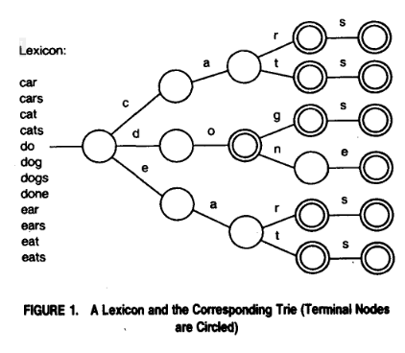
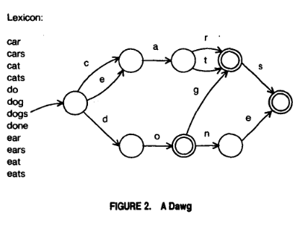
The minimum state recognizer will be a directed graph rather than a tree. The trie of Figure 1 may be reduced to the graph of Figure 2. Thus, a dawg (Directed Acyclic Word Graph) is basically a trie where all equivalent sub-tries (corresponding to identical patterns of acceptable word endings) have been merged. This minimization produces an amazing savings in space, the number of nodes is reduced from 117,150 to 19,853. The lexicon represented as a raw word list takes about 780 Kbytes, while our dawg can be represented in 175 Kbytes. The relatively small size of this data structure allows us to keep it entirely in core, even on a fairly modest computer.

Slide 12
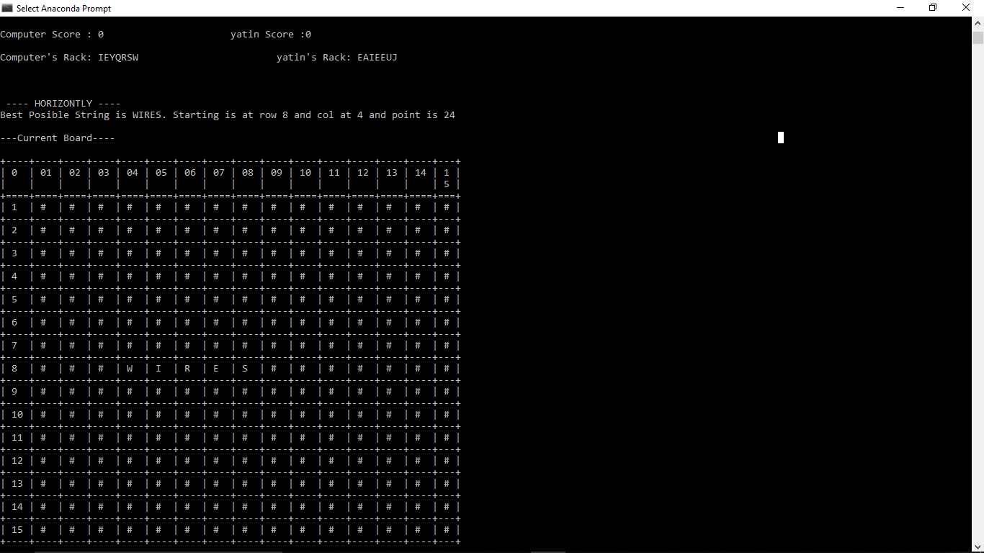
Working Model
Game will start at centre position.
Computer will make first move.
Here rack is made from random letters.
Computer will make the word which give maximum point.

Slide 13
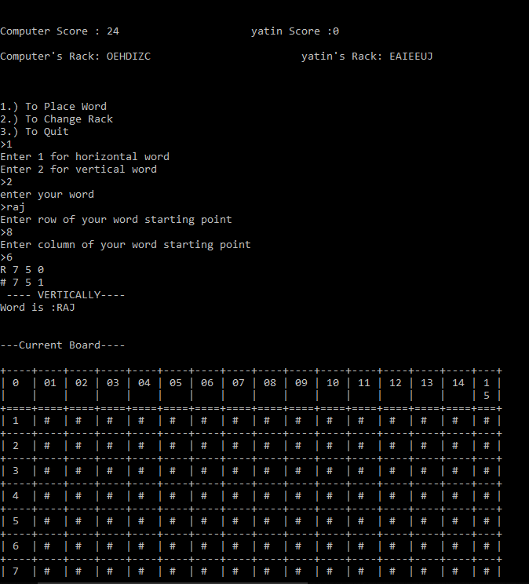
Now it’s user’s turn.
User have three option :
1) User can put valid word on board from rack.
2) User can change rack.
3) User can quit.

Slide 14
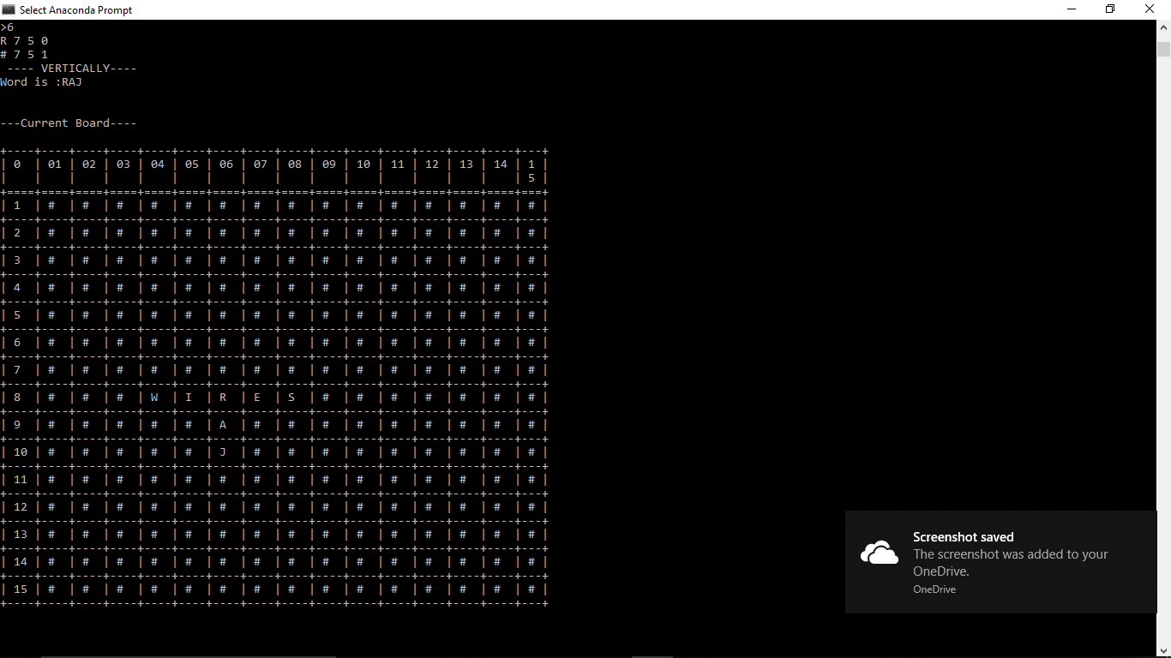
Here we can see change in scrabble board after user’s turn.

Slide 15
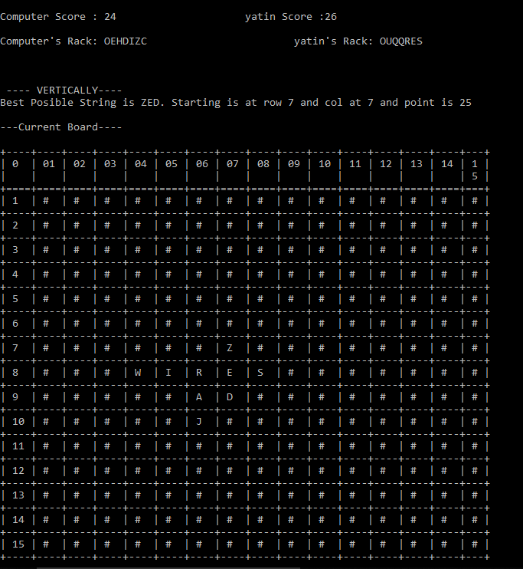
Now it’s computer’s turn.
We can see scores after every turn.

Slide 16
Constrains
When we put new word into scrabble board it may have possibility that it makes other words too. But in our algorithm we have not calculated points from other words.
In standard scrabble game number of letter is limited according to it’s language. But in our situation number of letter is random in bag.
Scrabble games ends when one player plays every tile on his or her rack, and there are no tiles remaining in the bag. But in our case scrabble game ends when player passes his or her turn and computer change it’s rack due to random number of letter.

Slide 17
UPDATED SCRABBLE (ONE STEP AHEAD)

Slide 18
Scrabble with removed Constrains
For removing first constrain we will use crossValue function. CrossValue function has two option. If we put word horizontally then it will check every vertical word associated with each letter of that word. And if we put word vertically then it will check every horizontal word and do the same procedure of above. Thus total point will be sum of word point and crossValue point.
For removing second constrain we will add fix number of tiles in our bag and we will choose randomly seven letter from that bag. If user choose less than seven tiles than remained tiles will be put in rack and other tiles will be chosen randomly from bag again. Thus number of tiles can be limited.

Slide 19
Since we limited our bag with fix number of tiles we can end this game easily. When the number of tiles are not enough to complete our rack, game will be ended.

Slide 20
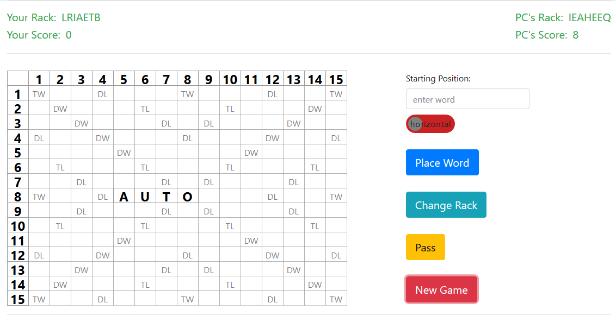
Scrabble with UI

Slide 21
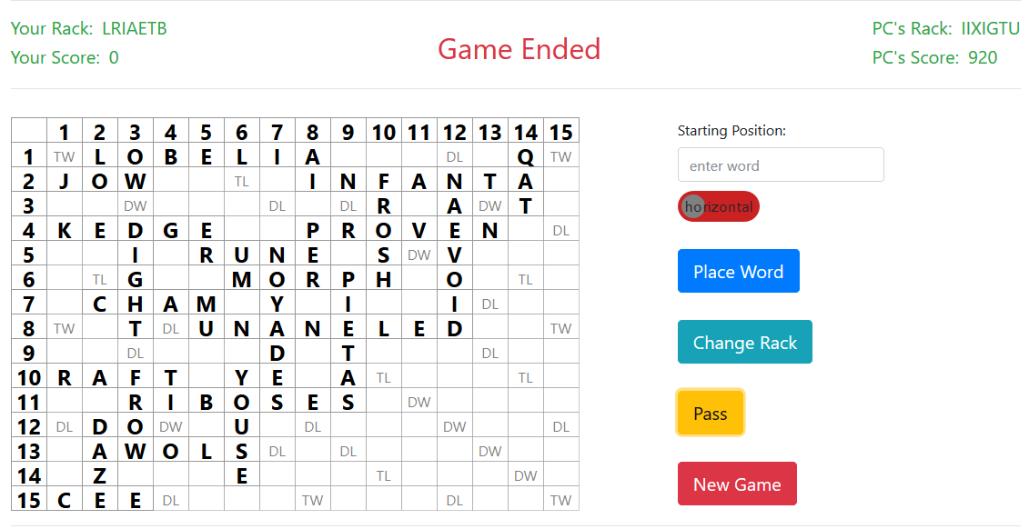
Game Ending

Slide 22
THANK YOU :)

